Slide 1
INSTITUTE OF AERONAUTICAL ENGINEERING (Autonomous) Dundigal, Hyderabad - 500 043
Academic Year: 2024-25
Department of Electronics And Communication Engineering
Four Review
Guided By:
C . Radhika
Assistant Professor
Title : Resistive Memory-Based In-Memory Computing: From Device and Large-Scale Integration System Perspectives
By:
23955A0410: M. Lavanya
22951A0496:E.Meghana
22951A04A1:B.Kanth

Slide 2
Outline
INTRODUCTION
ABSTRACT
AIM,OBJECTIVE
PROBLEM STATEMENT
PROJECT IMPLEMENTATION
BLOCK DIAGRAM
Existing Methodology
Proposed Methodology
CODE IMPLEMETATION
EXPECTED OUTCOMES
RESULT AND DISCUSSIONS

Slide 3
Introduction
This type of memory stores data by changing the resistance of a material. It offers advantages such as faster speeds, lower power consumption, and higher density compared to conventional memory types.
This approach integrates processing capabilities directly into memory. By doing so, it reduces the need for data transfer between the CPU and memory, which can be a bottleneck in traditional computing architectures.
This aspect focuses on the physical properties and performance of resistive memory devices, such as how they operate, their reliability, and scalability
This refers to how these resistive memory devices can be integrated into larger systems, including circuits and architectures, to enable efficient computing at scale.

Slide 4
Abstract
The exponential growth of data and the need for faster processing capabilities have highlighted the limitations of traditional von Neumann computing architectures, where memory and processing units are separated.
This project explores the potential of resistive memory (ReRAM) technologies to facilitate in-memory computing, allowing data processing to occur directly within memory cells.
By integrating processing capabilities with data storage, resistive memory systems can significantly reduce latency and energy consumption associated with data transfer.
The findings indicate that resistive memory-based in-memory computing systems offer substantial improvements in computational efficiency, positioning them as a viable solution for next-generation data-intensive applications.

Slide 5
AIM,OBJECTIVE
AIM:
To explore and evaluate the potential of resistive memory-based in-memory computing (IMC) technologies, focusing on both device-level characteristics and large-scale system integration, to address the challenges of conventional computing architectures.
Objectives
To analyze the fundamental properties and switching mechanisms
To investigate the computational capabilities
To assess integration strategies
To identify the challenges and potential solutions
To explore real-world applications

Slide 6
Problem Statement
The adoption of emerging RRAM technology demonstrates great potential in realizing more efficient computing systems, particularly for cognitive applications.
To enable large-scale integrated systems for real-world applications, however, there are still many key challenges to be solved, such as the imbalance between the limited device number and the increasing size of neural network models.
The difficulty in realizing online training schemes, the automation flow to transfer an algorithm to the given hardware platform, as well as the device robustness and system reliability issues
It is impossible to overcome them solely at a device level, while mitigation from circuits, systems, and even algorithms might be the only solution.

Slide 7
PROJECT IMPLEMENTATION:
Analyze the limitations of traditional computing architectures and identify the need for in-memory
computing using resistive memory technologies.
Study different types of resistive memory such as resistive RAM, phase-change memory, and
Magneto-resistive RAM, focusing on their working principles, switching mechanisms, and material properties.
Investigate how resistive memory can perform logic and arithmetic operations by leveraging
its resistance states for computation.
Design a small-scale resistive memory-based in-memory computing model at the device level, incorporating
key parameters such as switching speed, endurance, and power consumption.
Implement simulations to evaluate the memory cell behavior and its ability to execute basic
computational tasks like matrix-vector multiplication and logic operations.
Study the integration of resistive memory into large-scale computing systems,
considering factors like array organization, read/write circuitry, and interconnect challenges.

Slide 8
Matlab and verilog:
Model and simulate the behavior of resistive memory devices in various computational tasks
such as logic operations and matrix-vector multiplication.
Leverage built-in functions for matrix operations, signal processing, and optimization
to simulate memory-based computations.
Simulate system-level designs by integrating resistive memory with other processing
components, assessing performance metrics like power consumption, latency, and throughout
.
Visualize performance data through graphs and plots to analyze power vs. latency and other simulation results
.
Implement algorithms for testing on resistive memory systems to analyze
computational accuracy and efficiency.
Integrate MATLAB with circuit simulators (e.g., Simulink) to validate resistive memory circuit behaviors.

Slide 9
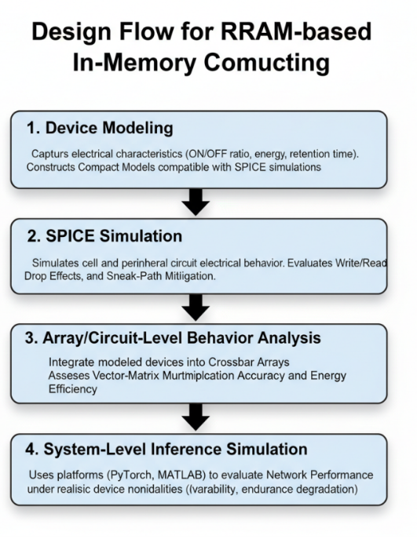
BLOCK DIAGRAM:

Slide 10
BLOCK DIAGRAM DETAILS:
1. Device Modeling
The electrical behavior of the RRAM device is captured, including ON/OFF ratio, switching energy, and retention. A compact mathematical model is created to represent its characteristics. This model becomes the foundation for later circuit-level simulations.
2. SPICE Simulation
The modeled device is simulated using tools like SPICE to analyze real electrical behavior. Read/write operations, voltage drops, and sneak-path effects are evaluated. This step helps verify device functionality before integration into larger arrays.
3. Array/Circuit-Level Behavior Analysis
Multiple RRAM cells are organized into a crossbar array for computation. Vector-matrix multiplication accuracy, energy efficiency, and scalability are assessed. This stage connects device performance to practical circuit-level functionality.

Slide 11
BLOCK DIAGRAM DETAILS:
4. System-Level Inference Simulation
The crossbar is tested with real workloads using platforms like MATLAB or PyTorch. Neural networks are mapped onto the array to analyze inference accuracy. Device variability, noise, and degradation effects are evaluated at application level.

Slide 12
Existing Methodology (Conventional & Early IMC)
Based on von Neumann architecture with separate memory and processor
Frequent data transfer causes von Neumann bottleneck
High latency and power consumption
Conventional CMOS logic → large area, low energy efficiency
Early In-Memory Computing existed mainly as:
Conceptual architectures
Simulation-based models
Focused only on either memory or computation, not both together
Limited demonstration of complete logic + arithmetic functions
Scalability issues due to data movement, variability, and power limits

Slide 13
Limitations of Existing Approaches
Memory and logic not fully integrated at device level
Mostly supports either digital logic or analog computing, not both
Lack of practical circuit-level examples (adder, MUX, etc.)
Poor suitability for large-scale AI and neuromorphic systems
Area, energy, and speed constraints remain unsolved

Slide 14
Proposed Methodology
Uses RRAM-based In-Memory Computing
Memory + computation merged in the same physical device
Resistance states represent data and perform computation
Exploits:
Ohm’s Law
Kirchhoff’s Current Law
Enables parallel vector–matrix multiplication inside memory
Supports both digital and analog operations

Slide 15
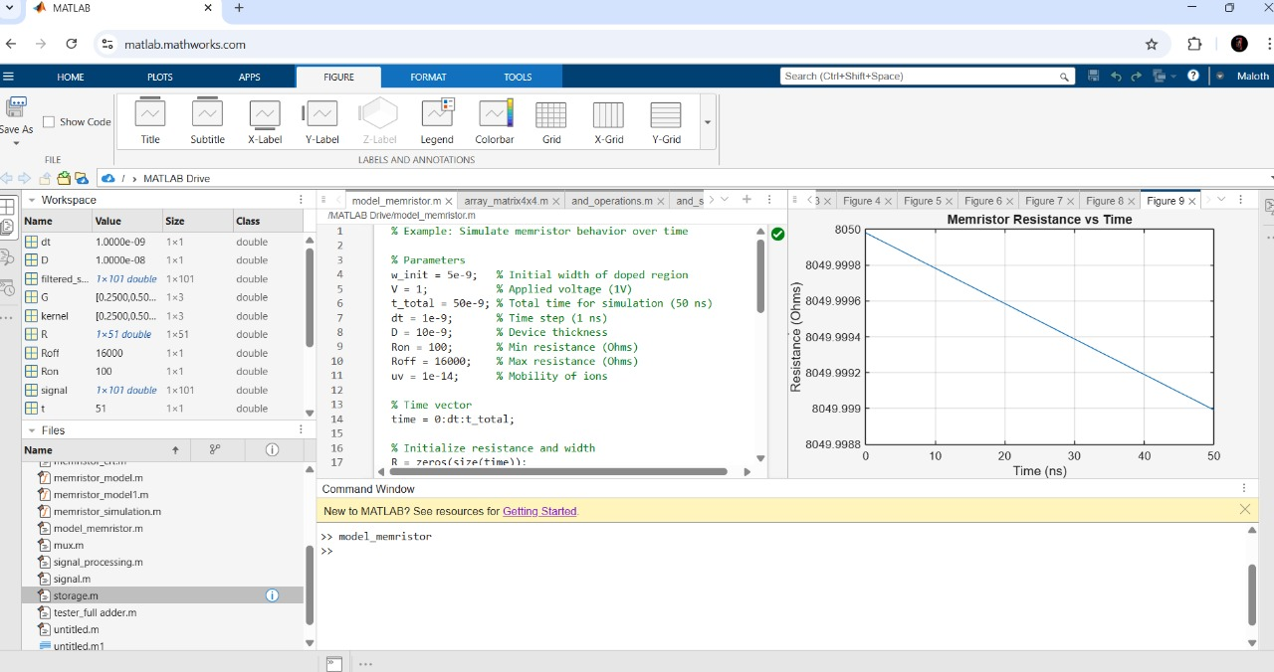
CODE IMPLEMENTATION:
Creating memristor model

Slide 16
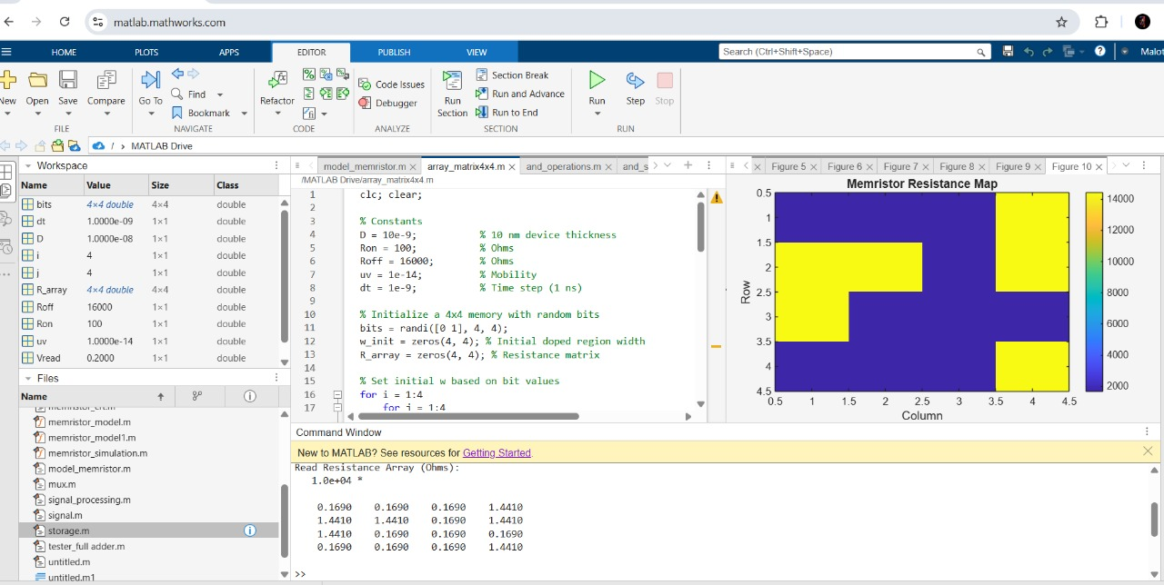
CODE IMPLEMENTATION:
Array matrix

Slide 17
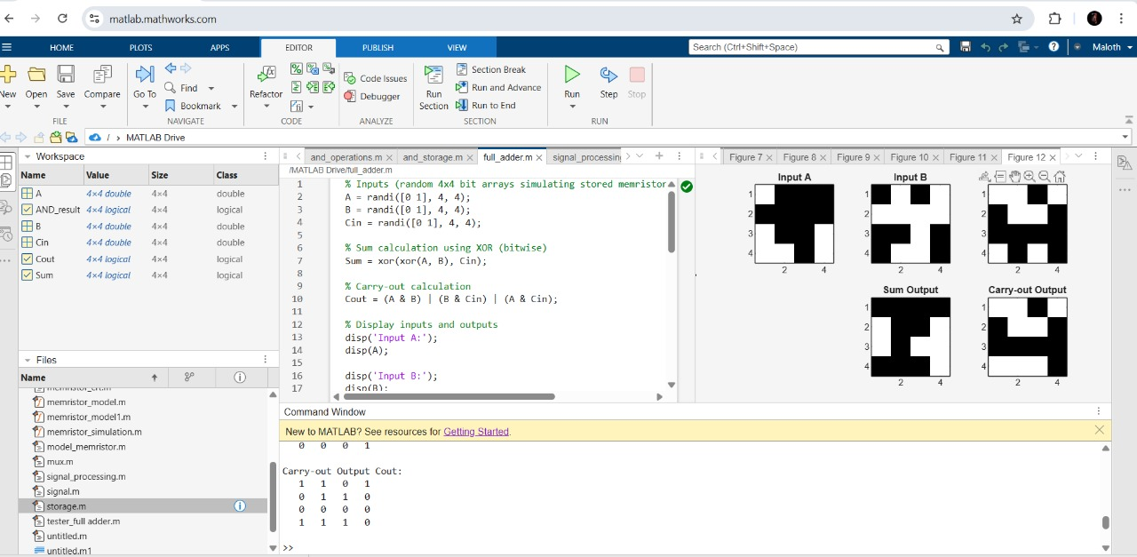
CODE IMPLEMENTATION:
Full adder In ADC:

Slide 18
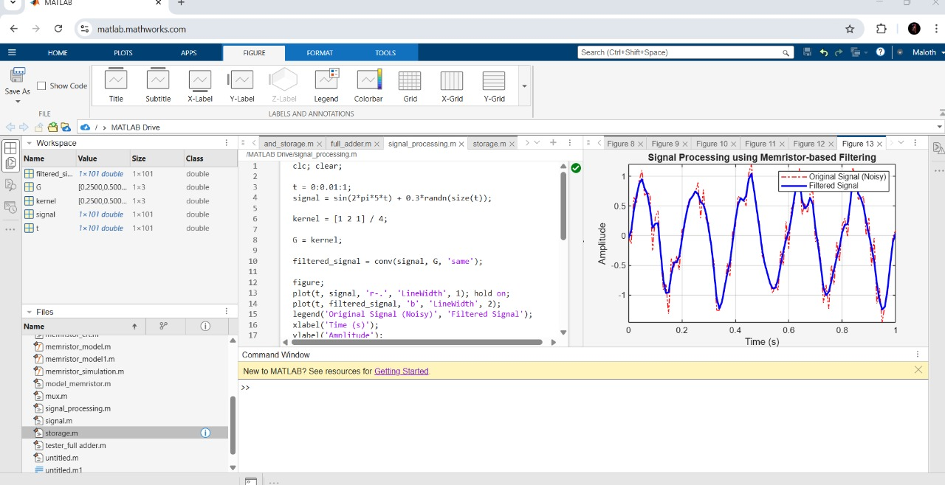
CODE IMPLEMENTATION:
Signal processing in DC:

Slide 19
RESULT AND DISCUSSION:
Simulation Results: The simulations demonstrate that resistive memory-based in-memory computing
significantly reduces power consumption and latency compared to traditional memory systems.
System Performance: The integrated resistive memory system achieves high parallelism,
enabling faster execution of computation-heavy tasks..
Energy Efficiency: The power consumption analysis reveals that resistive memory offers substantial
energy savings due to reduced data transfer and the ability to perform computations directly in memory.
Challenges Identified: Some challenges were observed, such as variability in device performance
due to non-ideal resistive switching and limited endurance in some resistive memory devices.
Scalability and Integration Issues: While resistive memory has significant potential, scaling to large
arrays and integrating with traditional processing units poses challenges, including managing
interconnects and maintaining signal integrity.

Slide 20
References
[1] J. Von Neumann, The Computer and the Brain, Yale University Press,
New Haven, 2012
[2] J. L. Hennessy, D. A. Patterson, Computer Architecture: A Quantitative
Approach, Elsevier, Burlington, MA 2011.
[3] D. Kuzum, R. G. D. Jeyasingh, B. Lee, H.-S. P. Wong, Nano Lett. 2011,
12, 2179.

Slide 21
THANK YOU………..

